Slide 1


Meeting Summarizer Bot Automation
ROBOTIC PROCESS AUTOMATION
Praveen S - 2303737714821030
3nd year B.E CSE(Artificial Intelligence and Machine Learning)
K.S.RANGASAMY COLLEGE OF TECHNOLOGY
(Autonomous)
Tiruchengode – 637 215, Namakkal Dt. Tamil Nadu
Notes:
1.7.2013
‹#›

Slide 2
INTRODUCTION
Meetings are essential for collaboration, but documenting them is often tedious and time-consuming.
Manual summarization can cause missed information or inconsistent notes.
Automation ensures accurate, consistent, and quickly available meeting summaries.
The Meeting Summarizer Bot in UiPath integrates with transcription and NLP technologies.
It captures key details such as decisions, action items, and follow-ups.
The bot can also detect the language of the meeting content automatically.
It translates the summary into the required language for easy understanding.
This automation removes repetitive work, enabling employees to focus on core tasks.
The project showcases how RPA enhances communication and knowledge sharing in organizations.
Notes:
1.7.2013
‹#›

Slide 3
ABSTRACT
Meetings often generate lengthy discussions, making manual summarization time-consuming and inefficient.
UiPath RPA automates the transcription, extraction, and summarization of meeting content.
The bot integrates with email and conferencing platforms to automatically capture meeting data.
AI and NLP technologies generate concise summaries that highlight key points and action items.
The bot detects the summary's original language and translates it automatically.
This ensures the summary is easy to read for everyone.
The final summary is automatically delivered to predefined or dynamic email recipients.
This automation reduces manual effort, enhances accuracy, and accelerates meeting documentation.
It improves decision-making and collaboration through timely and well-structured information sharing.
Notes:
1.7.2013
‹#›

Slide 4
KEY FEATURES AND BENEFITS
Key Features
Uses NLP to generate concise summaries of discussions.
Automatically sends summaries to predefined email IDs.
Detects meeting language automatically
Translates the summary to any required language..
Integrates seamlessly with email and conferencing platforms.
Benefits
Saves time by eliminating manual meeting note preparation.
Helps multilingual teams understand meeting updates easily.
Improves collaboration through timely sharing of summaries via email.
Supports faster decision-making with clear and actionable meeting insights.
Notes:
1.7.2013
‹#›

Slide 5
REAL WORLD APPLICATION AND USE CASES OF RPA
Business Meetings – Automatically summarizes project or board discussions and emails key highlights to all attendees.
Customer Engagements – Creates structured summaries of client conversations for easy reference and prompt follow-up.
Academic Institutions – Summarizes virtual classes, webinars, or group discussions for students and educators.
Medical Field – Captures and summarizes healthcare consultations or team discussions to ensure precise medical documentation.
Cross-Language Meetings – Instantly translates summarized discussions for teams speaking different languages.
Notes:
1.7.2013
‹#›

Slide 6
TOOLS USED
UiPath Studio – Used to design and build the entire meeting summarization workflow.
UiPath Integration Service Activities – Connects AI services for summarizing, detecting language, and translating text.
UiPath Microsoft Office 365 Activities – Sends the final translated summary to users through Outlook mail.
UiPath System Activities – Handles core actions like reading files, logging messages, and assigning variables.
Text File (Notepad) – Stores the long meeting notes used as input for summarization.
Outlook – Delivers the formatted meeting summary to all recipients.
Notes:
1.7.2013
‹#›

Slide 7
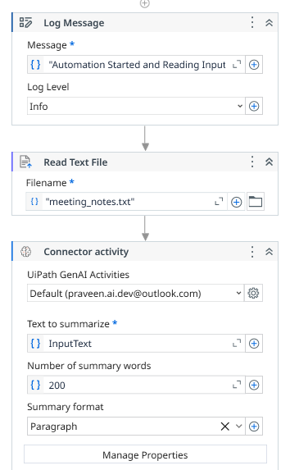
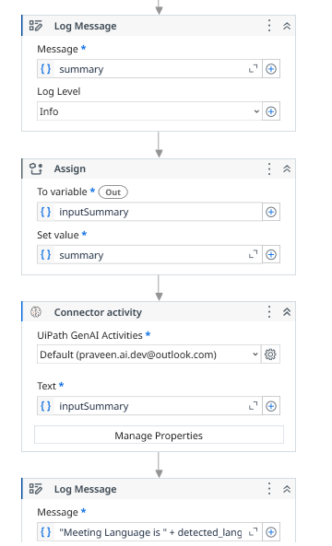
WORK FLOW
Notes:
1.7.2013
‹#›

Slide 8
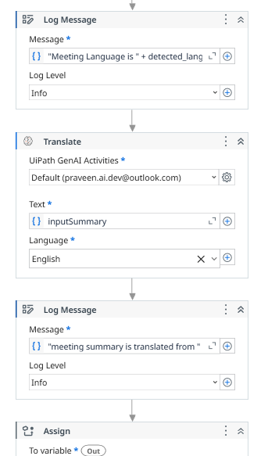
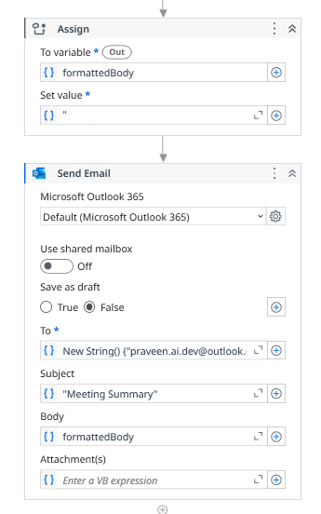
WORK FLOW
Notes:
1.7.2013
‹#›

Slide 9
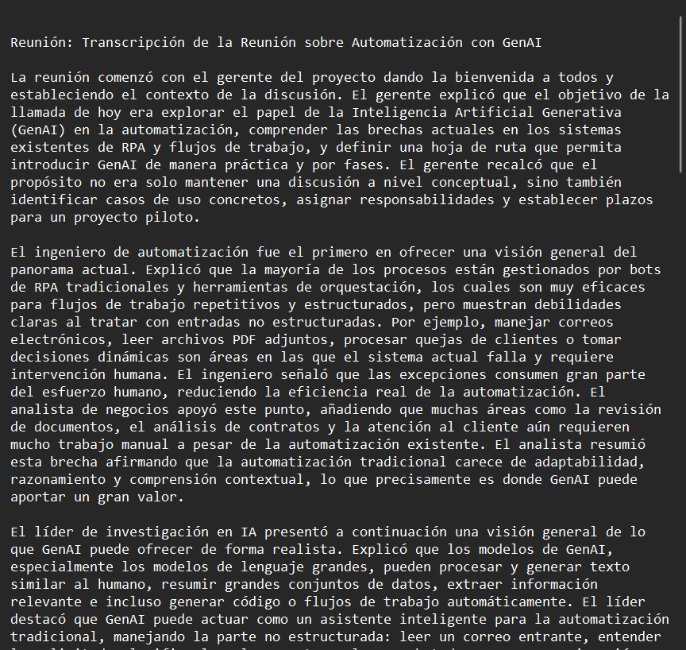
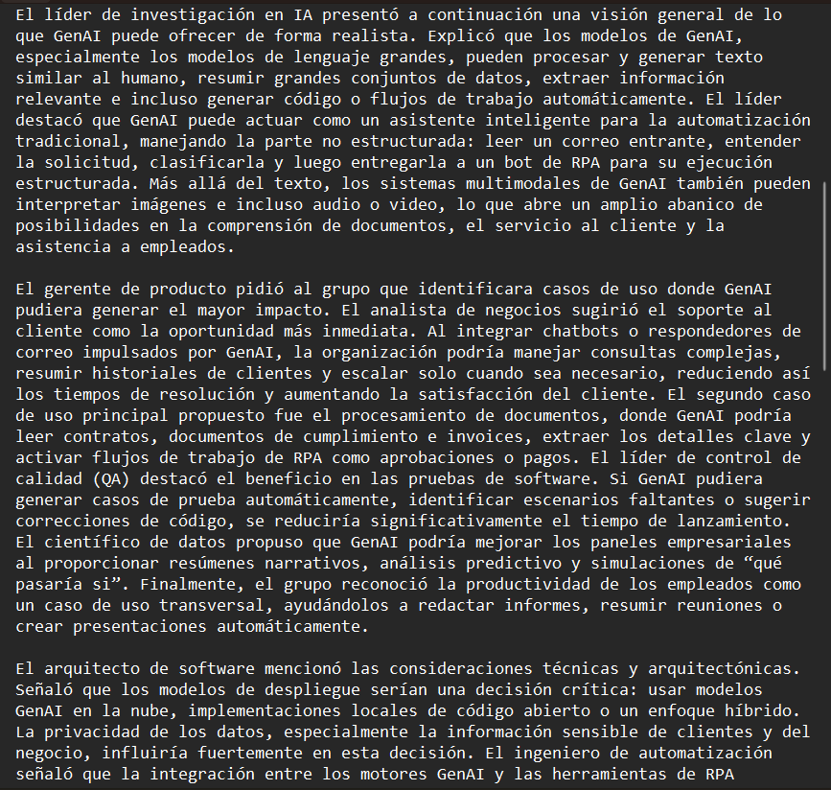
INPUT
Long meeting notes in unknown language :
Notes:
1.7.2013
‹#›

Slide 10
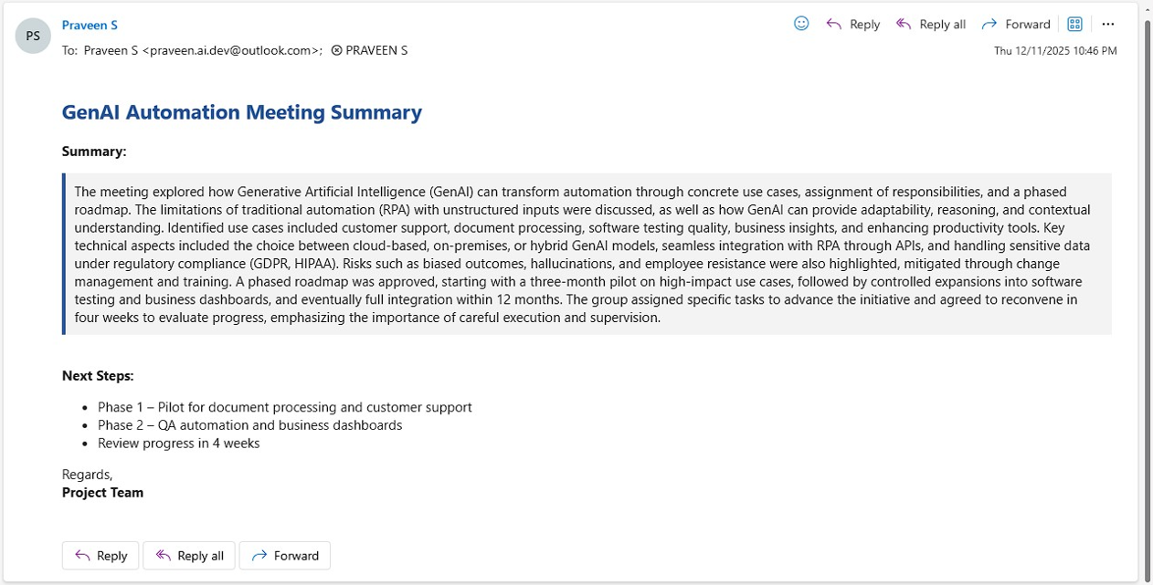
OUTPUT
Notes:
1.7.2013
‹#›

Slide 11
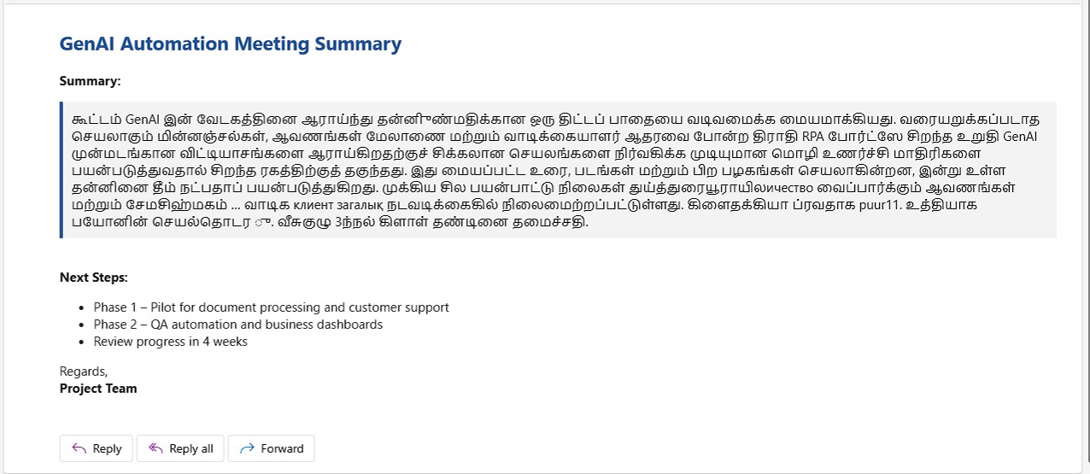
OUTPUT
Notes:
1.7.2013
‹#›

Slide 12
PROCESS
Open UiPath Studio and create a new workflow.
Read the meeting notes from the text file.
Log the start of the automation.
Summarize the long meeting content using AI.
Log that the summary is created.
Detect the language of the summarized text.
Translate the summary to the required language.
Format the translated summary into an email body.
Send the summary to recipients through Outlook.
End the workflow and verify the email delivery.
Notes:
1.7.2013
‹#›

Slide 13
CONCLUSION
The Meeting Summarizer Bot automates the entire process of reading, summarizing, detecting language, and translating meeting notes. It reduces manual work, improves accuracy, and ensures quick delivery of clear and readable summaries to all recipients. This automation enhances communication, saves time, and supports efficient decision-making across teams. It provides a reliable and consistent way to share meeting insights with everyone.
Notes:
1.7.2013
‹#›

Slide 14


Thank You !
LEARNING never stops.
Let's keep pushing the boundaries of ENGINEERING..
Thank you for your ATTENTION…
/ksrct1994
www.ksrct.ac.in
Notes:
1.7.2013
‹#›

